Slide 1


Intro to AI for Dev @ Improving
AI Workshop
Photo by Steve Johnson on Unsplash

Slide 2
Class Prep
To deliver this class:
Email a week or more in advance with pre-reqs
Run through labs yourself
Understand where you are demoing what. Flow goes:
Context
Prompts
Windsurf IDE assistance in completion and chat
Creating user stories
Agent creation of a feature
Be aware that prompts for the demos/labs are in the speaker notes
If

Slide 3

Learning Objectives
Hands on experience with AI in IDE
Understand importance of context
Know what a good prompt looks like
Expand AI knowledge and use of AI in development activities
Encourage interest in AI assistance and use of agents in development
Notes:
“By the end, you’ll have used agents to:
turn requirements into user stories,
implement features,
refactor code, and
create/review PRs.”

Slide 4



Ground Rules
Turn on your video and your mics
Jump in with your thoughts and questions
Notes:
Encourage collaboration.

Slide 5
Prerequisites
Should have already done this
Windsurf ready to use
Follow the instructions in the welcome email (from no-reply@windsurf.ai)
If you don’t receive a welcome email, the instructions are available on Improving’s SharePoint
Clone the workshop repo
https://github.com/improving/Intro-to-AI-for-Dev-Workshop
Open QUICKSTART.md in the cloned repo and follow steps 1 through 4

Slide 6
Quick Note
The tools we are using in this course are being used to teach the concepts. The AI landscape is changing drastically. Thus, the tools you use may be different, but will provide similar functionality.
This content will be updated quarterly to address changes in the technology.

Slide 7
Let’s Begin
Notes:
Now that we’ve covered some basic information about the course, let’s jump in.

Slide 8
The Trust Evolution: 8 Stages of AI Maturity
8
7
Orchestrate
6
Supervise
AI for Developers
5
Coordinate
4
Delegate
3
Workflow
2
Task
1
Off the shelf
Zero AI
Wave 1: Tools
Wave 2: Process
Wave 3: Agentic Operations
As trust increases, humans shift from doing to directing
3
Notes:
This is the maturity progression. Everyone is somewhere on here, both personally and in their department. This typically doesn't apply to an organization as a whole because it's domain-specific — your accounting department may be in a different place than your sales department.
Stage 0 (Zero AI): You don't use AI for work. Maybe you write a Valentine's note with ChatGPT, but that's not work output.
From the Gallup workforce survey for 2025: less than 10% of knowledge workers use AI at least once a week. Those results are almost identical to 2020. Adoption has stalled hard because people don't understand how to overcome the walls between these waves.
These are big shifts, not in the technology, but in how we approach work. There's also an identity issue — 'I AM a controller' vs. 'I do controlling.' When you tie identity to the activity, AI becomes threatening.

Slide 9
The Trust Evolution: 8 Stages of AI Maturity
Agentic Development at Scale
How to Trust AI
8
7
Orchestrate
AI Roundtable
Supervise
6
AI for <Role>
5
Coordinate
AI Discovery Overview
4
Delegate
3
Workflow
2
Task
1
Off the shelf
Zero AI
Wave 1: Tools
Wave 2: Process
Wave 3: Agentic Operations
As trust increases, humans shift from doing to directing
3
Notes:
This is the maturity progression. Everyone is somewhere on here, both personally and in their department. This typically doesn't apply to an organization as a whole because it's domain-specific — your accounting department may be in a different place than your sales department.
Stage 0 (Zero AI): You don't use AI for work. Maybe you write a Valentine's note with ChatGPT, but that's not work output.
From the Gallup workforce survey for 2025: less than 10% of knowledge workers use AI at least once a week. Those results are almost identical to 2020. Adoption has stalled hard because people don't understand how to overcome the walls between these waves.
These are big shifts, not in the technology, but in how we approach work. There's also an identity issue — 'I AM a controller' vs. 'I do controlling.' When you tie identity to the activity, AI becomes threatening.

Slide 10
And so much more…
ImprovingU will be bringing more and more AI related topics throughout the year that will help you go deeper and deeper.
You can and should dive into more learning about AI. Some suggested topics?
Specification Driven Developer – specifically BMAD method, OpenSpec, and others.
MCP Servers – specifically Playwright MCP, Context7 MCP, and Shadcn MCP

Slide 11
Where are you on your AI journey
Are you using AI in your development work?
Haven’t used it yet.
Regularly use prediction/completions when I write code.
Chat over my code to understand it and how I can improve it.
Use agents to assist my development work.
Agents write all my code. I guide and review the work.
Notes:
(3 minutes)
This question is to help the instructor understand where the audience is with their AI skills. There is the potential to reduce the time spent on IDE AI Assistance and bring in more agentic content if the instructor is comfortable with the concepts and the audience is overwhelmingly experienced with AI assistance.

Slide 12
AI Grounding & Context
AI in the IDE: What Are We Actually Using?
We’re using large language models (LLMs)
The AI generates text/code by predicting what comes next
It doesn’t “run” your code - it reasons from patterns + context
Quality depends heavily on:
The context the AI can see
The prompt you write
Notes:
(5 minutes)
Goal: Provide background on AI assistance in IDE tooling
Duration: 3 minutes
What you say
Before we have AI assist us on development tasks, I want to ground what we’re actually using here.
In Windsurf, most of what you see—inline suggestions, chat, agentic workflows—is powered by large language models, or LLMs.
At a simple level, they generate text or code by predicting ‘what comes next’ in a sequence, based on patterns they learned during training.
They don’t execute your code or run it like a debugger. They reason from patterns and from the context we give them.
That means the quality of the help you get is shaped by two big things:
the prompt (what you ask), and
the context they can see (files, cursor position, selection, history).
Everything in today’s lab—IDE assistance, agentic feature development, MCP—sits on top of those two fundamentals: prompt + context.”

Slide 13
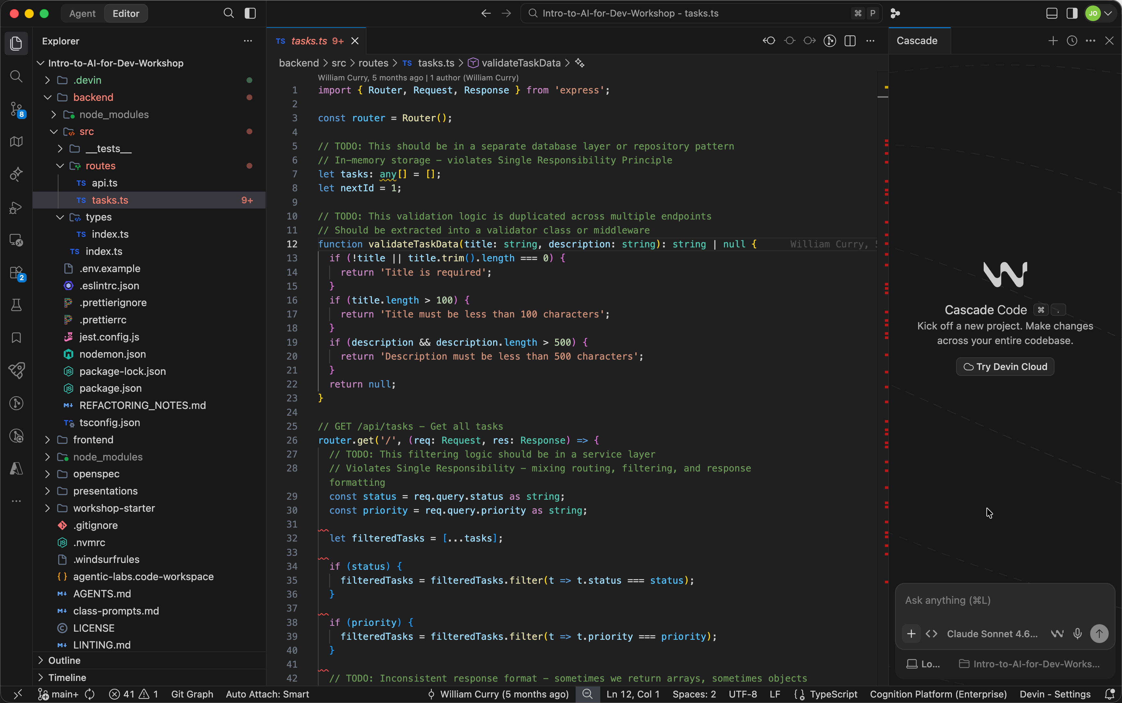
Windsurf Cascade
Window area view/hide
Windsurf IDE Agent
CTRL – L to open
Chat here (CMD L on Mac)
Notes:
(3 minutes)
Show Windsurf or just this slide. This is to highlight where the AI panel is in Windsurf.
Say: Let’s take a second to understand where you interact with AI in Windsurf IDE. Just show how to get to the AI panel for now. We’ll show examples in a little bit.
Windsurf Overview:
UI Familiarization: This is where the agent lives, this is how you chat, this is how it edits files.
Cascade Features:
MCP: Model Context Protocol tools for extending the capability of the AI.
Memory: Auto-generated context elements that Windsurf uses to remind itself of important context
Rules: Manual guidelines that you can use to provide guidance. Automatically added to context
Workflow: Manually created prompts that can be reused with “/” command
Task list: List of planning tasks created/edited via prompting
Hooks: Shell scripts that can be run before/after key events like read/write code file, run terminal command, or using MCP tool.

Slide 14
AI Context
Notes:
Let’s dig into context and how it applies in Windsurf.

Slide 15
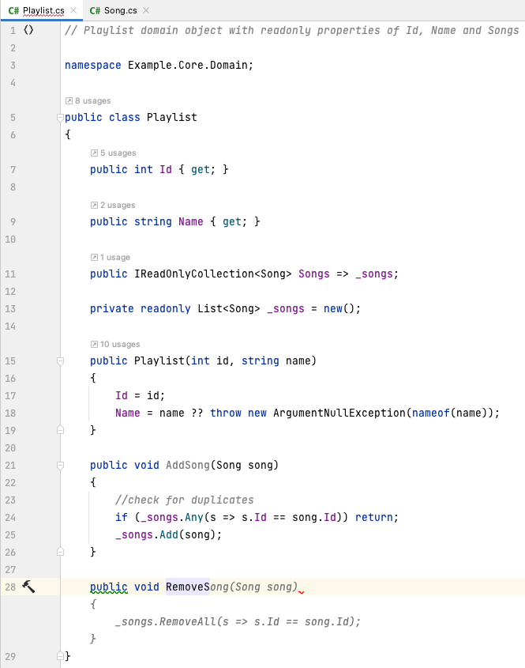
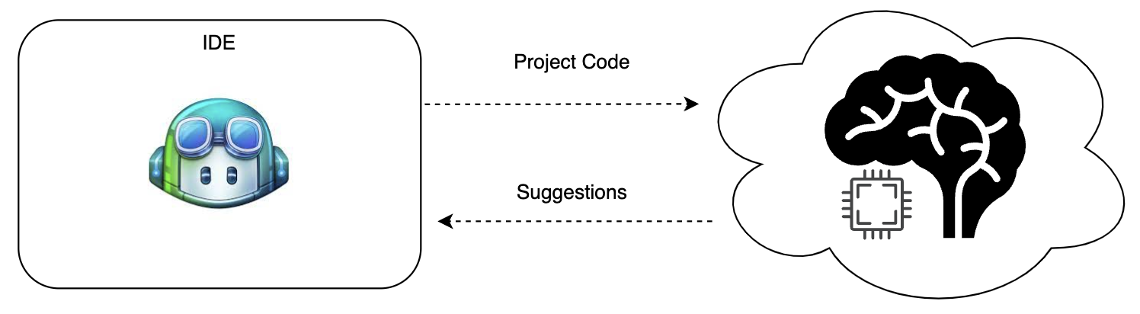


Code Completion Context
...
Current Selection
Cursor Location
Current File
Comments
Other open tabs
Function Names
Others...
Notes:
Call out that not every IDE will handle these the same!
(5 minutes)
Goal: Paint a clear picture about how the AI assistant in the IDE knows your context.
Duration: 3 minutes
What you say:
Context dramatically changes the answer you get.
In Windsurf, the model can see:
The file you’re in, and often the surrounding code and project structure. If your prompt says ‘fix this function’, it will use that local code as context.
Your selection or cursor. If you highlight a block and ask ‘refactor this’, that selected region becomes the star of the show. If nothing is selected, it may have to guess what you mean.
The conversation history in the chat panel - previous questions, explanations, and code snippets you pasted. A prompt on message #5 is influenced by what you said in messages #1 thru 4.
Plus workspace and tools: repo-wide search, test commands, and, in more advanced setups, MCP tools that expose APIs or systems.
Here, we are focusing on context for Code Completion. Let’s look at other context uses.
A nice rule of thumb is: ‘Show, then ask.’ Paste the relevant snippet or point the agent at the right file first, then ask your question. The better you control context, the better and more reliable the answers you get

Slide 16
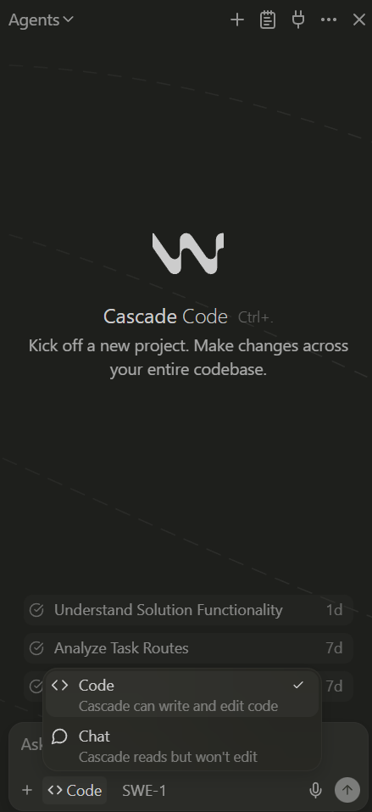
Chat Context / Modes
...
Codebase Index
Explicitly Added Files / Folders / Functions @
Prompt / Chat History
Agent Tools / MCP
Instructions / Rules
Docs
Others...
Notes:
Reminder not every IDE will handle these the same!
(3 minutes)
Goal: Paint a clear picture about how the AI assistant in the IDE knows your context for chat.
Duration: 3 minutes
What you say:
We’ve looked at context for Code Completion. You can also leverage AI in the Chat window. The context is similar, but Windsurf will use its code index to understand your entire code base and you can also reference files with @
Paste the relevant snippet or point the agent at the right file first, then ask your question. The better you control context, the better and more reliable the answers you get

Slide 17
AI Prompts
Notes:
Now that we understand Context, let’s talk about how to create an effective Prompt for our Chat interactions

Slide 18
Principle 1: Write Clear and Specific Instructions
Importance of Clarity
Clarity is essential when providing instructions to your AI. Clear communication leads to better understanding and outcomes.
Specific Instructions
Specific instructions help the model understand your needs more effectively, leading to more relevant and accurate responses.
Articulate Response Preferences
Be clear about your expectations of how the response will be given to you.
Notes:
(3 minutes)
When interacting with AI Chat, clarity is key. Providing specific instructions helps the model understand your needs and deliver relevant responses. Always aim to articulate your requests clearly and concisely for better outcomes.

Slide 19

Prompt Structure Tip: RTCC
Roles = Who
Task = What
Context = Why
Constraints = How
Notes:
(3 minutes)
This slide presents a valuable tip for structuring prompts using the RTCC format. By clearly defining the Role, Task, Context, and Constraints, we can enhance clarity and ensure that all necessary information is communicated effectively. For instance, specifying 'Role = Who' helps identify the key stakeholders involved, while 'Task = What' outlines the specific actions required. 'Context = Why' provides the rationale behind the task, and 'Constraints = How' highlights any limitations or guidelines that must be followed. This structured approach not only aids in comprehension but also facilitates better decision-making and collaboration among team members.
Fun fact this speaker note was created by AI ______

Slide 20
Try: Roles, Task, Context, Constraints
Make sure to use the same AI conversation
ROLE (pinned)
•You are my senior full-stack partner. Prefer small, reviewable diffs and testable outcomes.
TASK (Ideate)
•Propose 3 distinct designs for a Subscription Selection page. For each, specify:
•FE components/routing/state + a11y notes + test approach;
•BE endpoints/DTOs (e.g., GET /api/plans) + migration/seed + tests.
•Return a comparison table (Complexity, Risk, Delivery Time, UX/A11y, Testability) and recommend ONE for speed + reliability.
•Then produce a 3–5 step plan (risk-ordered) for the recommended design and list acceptance tests for Step 1 and any context I must provide.
CONTEXT (pinned)
•App: Coffee2Live — Subscription Selection feature (read-only).
•FE: React 18 + Vite + TypeScript + React Router + React Query + Testing Library + Tailwind.
•BE: FastAPI + Pydantic v2 + SQLAlchemy + Postgres + Alembic + pytest.
•Goal: tiny, demo-friendly slice; keep client IP private; seed fake data.
•Dev Environment: PowerShell + Windows Machine.
CONSTRAINTS (pinned)
•Always return a file list, full code for changed files, and run commands.
•Include tests (unit + ≥1 FE integration) and basic a11y (keyboard + ARIA).
•Keep scope small; no checkout/auth beyond a stub.
Notes:
(5 minutes)
Students evaluate the impact of better specification through RTCC
Do you notice differences between the outputs you received? Ask the AI to explain the difference (Ex: Jamaica may not be included)
Is the distance estimate consistent between both reports? Ask the AI to perform a consistency check and update both the Price Report and Country Report as needed to align.
Roles: You are an AI logistics and sourcing specialist with expertise in global shipping rates and coffee supply chains. I am a business leader at Coffee2Live.
Task: List top countries growing high-quality coffee.
Context: Assembling potential suppliers within 5,000 miles of Houston, TX. Refer to results as Price Report.
Constraint: Tabular format showing Country Name, Distance (miles, ascending order), and Shipping Cost (for a 152 lb bag, USD range, based on standard freight rates). Limit to top 10 closest.
Roles: You are an AI global coffee sourcing expert with access to real-time data on producers and logistics. I am a coffee quality analyst at Coffee2Live.
Task: List top countries growing a variety of high-quality coffee beans.
Context: Assembling suppliers within 5,000 miles of Houston, TX. Refer to results as Country Report. Example: "1. Colombia (~2,200 miles) - Flavors: Rich, citrusy; varieties like Arabica and Castillo."
Constraint: Summarize top 10 closest by distance (ascending order). Include key characteristics (flavor, bean type). Limit 500 words; use bullet list format.

Slide 21
Principle 3: Refine & Re-Prompt
Pro Tip: You can get AI to help you refine your prompt
Refining Your Prompt
Refining your prompt involves clarifying your questions to improve the response quality from the model.
Use AI to update the prompt
Getting AI to create prompts for future use can be a tremendous time saver
Adjust Context and Constraints
Adjusting context and constraints can significantly enhance the usefulness and relevance of the answers.
Notes:
(3 minutes)
If the output isn't satisfactory, refine your prompt and re-prompt the model. Adjusting your questions or providing more context can often lead to a more relevant and useful response from the AI.

Slide 22
IDE AI Assistance
AI assistance in Windsurf
Inline suggestions
Small completions (predictions) while you type
Chat about code
Explain, debug, generate snippets, doc comments
Adding Context
Explain code file
Code actions / refactors
“Refactor this”, “extract method”, “add tests”
Project-wide help
Summarize files, find usage patterns, suggest designs
Goal: augment your workflow, not replace you
Notes:
(10 minutes)
Goal: Provide understanding of type of AI assistance they can use and how to effectively start the assistance
Duration: 10 minutes
What you say:
Let’s pull the context and prompt background together and put it all to practice.
Windsurf gives you a few main modes:
Inline suggestions: those ghosted gray lines that appear as you type. Great for small, local patterns—loops, conditionals, simple functions.
Chat about code: open the chat panel and ask it to explain a function, debug an error, propose a better algorithm, or write doc comments. This is your ‘explain and brainstorm’ mode.
Code actions and refactors: highlight some code and ask, ‘Refactor this into a helper,’ or ‘Add tests for this function.’ This is where you start delegating small refactoring and test-writing tasks.
Project-wide help: ask, ‘Where do we handle task creation?’ or ‘Summarize how tasks flow from API to UI.’ The model can search and reason across multiple files.
The mindset here is: AI is meant to augment your workflow, not replace you. You still own the architecture and the decisions; the AI just takes care of a lot of the routine typing and initial drafts.
Demo Steps:
Using the provided repo, demonstrate each of the activities to the class. Use backend/src/routes/tasks.ts to show interaction to students.
AI prediction in editor
Ask some questions about the code:
What does this code do?
What design pattern does this follow?
Have the class open the file in Windsurf and provide questions to try out and have them try it in their own Windsurf (have them follow along at this point and share what they have discovered)

Slide 23
Agentic Development
Notes:
Now that we understand how the IDE can provide assistance while we are developing, let’s expand these concepts to have the AI help us write code.

Slide 24
Agentic AI Development
Agentic AI
Autonomous agents that can handle complex multi-step tasks that may involve applying some reasoning
Agentic Development
Treating AI as an active collaborator through the whole dev loop: understand → plan → implement → test → review
Our Goal
Use Windsurf IDE and AI Tools to have agents:
Draft requirements
Turn requirements into user stories
Implement features
Refactor code
Create and review PRs
Notes:
(5 minutes)
Goal: Get everyone ready to code, with minimal talk.
What you say (high level)
“In this session, we’ll build and refactor a small web app using Windsurf’s AI agents as a pair programmer and reviewer.”
“We’re going to spend most of our time actually coding and using the agent, not just talking about it.”
Steps
Welcome & expectations (1 min)
“By the end, you’ll have used agents to:
turn requirements into user stories,
implement features,
refactor code, and
create/review PRs.”
Quick agentic dev definition (1 min)
“Agentic development = treating the AI as an active collaborator through the whole dev loop: understand → plan → implement → test → review.”
Show one slide or speak over the Windsurf UI: “This is where the agent lives, this is how you chat, this is how it edits files.”
Environment check (3 min)
Ask everyone to:
git clone the repo (if not already).
Install dependencies.
Run the app.
While they do this, you walk around and spot-fix issues.
Checkpoint before moving on
Most people can:
open the repo in Windsurf,
run the app locally.
If some are behind, pair them with someone who’s ready for later exercises.
Agentic AI:
Autonomous agents that can handle complex multi-step tasks that may involve applying some reasoning
Managed through context

Slide 25
Agent Assisted User Stories
Planning – Creating Task List
App scenario - Task Tracker
Instructor live demo:
Paste rough requirements into Windsurf agent.
Ask agent to turn them into 4–6 user stories + acceptance criteria.
Using an agent inside Windsurf to refine natural-language requirements into INVEST-style user stories.
Generating acceptance criteria and edge cases via AI.
Ask agent to tag stories by complexity (S/M/L).
Notes:
(12 minutes)
Present the app scenario in 1–2 minutes (e.g., “Task Tracker”).
Goal: Show how to go from rough requirements → clean user stories & acceptance criteria with the agent. In a future class we will show you how to do this better.
Time: 10 minutes
What you say
“We’re going to start where most real work starts: messy requirements.”
“Instead of manually crafting user stories, we’ll have the agent help us create INVEST-style stories with acceptance criteria.”
“There are better ways to do this so don’t get too hung up on the process we are showing here. This is just to give us some data for this class.”
Demo steps (in Windsurf)
Show the app concept (2–3 min)
Describe the scenario verbally or on a slide:
“We’re building a simple Task Tracker: users can add tasks, mark them complete, and filter by status.”
Paste that brief description into the agent chat.
Example prompt to the agent
You are a product owner helping a dev team. Based on this description of a simple Task Tracker app, generate 6 user stories in standard format ("As a [role], I want [feature], so that [value].") and for each, list 3–5 acceptance criteria with edge cases. Prioritize the stories as S (small), M (medium), or L (large).
Review and adjust (5–7 min)
Walk through a couple of generated stories.
Ask the agent to refine one:
Refine story #2 to be smaller and more specific. Make sure acceptance criteria are testable.
Highlight:
Clear roles
Testable acceptance criteria
S/M/L sizing
Facilitator tips
If the group is experienced, ask them:
“What’s missing from these stories?” then ask the agent to add it.
Share the stories with the students at the end as they will need them for the Feature Implementation slide.
Save the stories to a file in the repo (e.g., docs/user-stories.md).
Checkpoint before moving on
You have a list of ~4–6 stories with acceptance criteria.
Everyone understands which 1–2 stories they’ll implement later.
***** SAMPLE PROMPT *****
We're building a simple task tracker - users can add tasks, mark them complete and filter by status. You are a product owner helping a dev team.
Based on this description of a simple Task Tracker app, generate 6 user stories in standard format
("As a [role], I want [feature], so that [value].") and for each, list 3–5 acceptance criteria with edge cases.
Prioritize the stories as S (small), M (medium), or L (large).

Slide 26
Guided Coding DEMO
Coding – Implement Small Story and Test
Use agent to:
Identify affected files (front-end + back-end).
Propose a simple design/update (API shape, state, UI element).
Generate or modify code (component, route, model, etc.).
Run app/tests and:
Ask agent to help debug any errors.
Ask agent to:
Suggest unit test(s).
Create a good commit message.
Notes:
(10 minutes)
Goal: Model the exact agentic workflow they’ll follow in lab time.
What you say
“Now I’ll implement one small story using the agent. You’ll follow a similar pattern in your own story.”
Demo steps
Pick a small story
Example: “As a user, I can add a new task with a title and status so that I can track my work.”
Ask the agent to restate and plan
Here is a user story from our list: "As a user, I can add a new task with a title and status so that I can track my work." In this codebase, propose a step-by-step implementation plan: - Which files to modify or create (front-end and back-end)? - What data structures / API changes are needed? - How will we test it?
Briefly discuss the plan.
If it’s off, ask for a revised plan that’s simpler or better aligned with your architecture.
Implementation with the agent (the fun part)
For the backend (if applicable):
Implement step 1 and 2 from your plan: - Add a POST /tasks endpoint to accept { title, status } - Store tasks in the existing in-memory list. Please propose the changes to [file path], preserving existing behavior.
Let the agent propose a patch.
Review quickly, then accept/adjust.
For the frontend:
Implement the "Add Task" UI you described: - Simple form with title and status dropdown. - On submit, call POST /tasks. - On success, refresh the task list. Modify [component file] and any other needed files.
Run and debug with the agent
Run the app; intentionally don’t fix everything by hand.
Use the agent:
I get this error when submitting the form: [paste error]. Diagnose the root cause and suggest a minimal fix in the relevant files.
Ask for tests and commit message
Now write unit tests or integration tests to cover the acceptance criteria for this story. Use the existing test framework in this repo. Also, summarize the change in a concise conventional commit message.
Facilitator tips
Narrate your thought process:
“I’m not blindly accepting what it gives me; I’m checking that it matches the story.”
Keep momentum: don’t get bogged down in styling; focus on the agentic flow.
Checkpoint before moving on
One story is fully implemented and tested in front of them.
They’ve seen: story → plan → code → test → small commit.
***** SAMPLE PROMPT *****
As a user, I want to see all my tasks in a list, so that I can quickly review what needs to be done.
Acceptance Criteria:
All tasks display with title, description, status, and creation date
Tasks are sorted by creation date (newest first)
Empty list shows "No tasks yet" message
Long titles truncate with ellipsis after 50 chars
Tasks display appropriate status indicators/colors
In this codebase, propose a step-by-step implementation plan:
- Which files to modify or create (front-end and back-end)?
- What data structures / API changes are needed?
How will we test it?
--- Then, after review ---
Implement the "Add Task" UI you described:
- Simple form with title and status dropdown.
- On submit, call POST /tasks.
- On success, refresh the task list.
Modify code in frontend and any other needed files.

Slide 27
Feature Implementation
Hands On Sprint #1
Work in pairs (we'll send to rooms)
Using the story provided by the instructor:
Ask the agent to outline a step-by-step implementation plan.
Use the agent to implement and test the code:
Generate/modify code.
Generate/update tests.
Run the app/tests and iterate with the agent until acceptance criteria are met.
Notes:
(25 minutes)
Goal: Learners implement at least one story using the agent themselves.
Structure:
Learners work in pairs (recommended) or solo.
Each group picks a small or medium story from the list.
For their story, they will:
Ask the agent to restate the story and acceptance criteria.
Ask the agent to outline a step-by-step implementation plan.
Use the agent to:
Propose file changes.
Generate / modify code.
Generate/update tests.
Run the app/tests and iterate with the agent until acceptance criteria are met.
Instructor role:
Circulate, prompt them to “ask the agent first” before you help.
Follow these steps, and always ask the agent first before you ask me.”
Steps (display on slide or handout)
Restate and clarify the story
Here is a user story I want to implement: [paste story] Restate it in your own words and list the acceptance criteria. Then, propose a concrete implementation plan for this codebase.
Identify files to change
Based on this repo’s structure, list the exact files you recommend changing or creating to implement this story.
Generate/modify code
Implement step 1 from your plan in [file path]. Show me the diff and explain what you’re changing in comments.
Encourage them to do one step at a time, not the whole story at once.
Ask for tests
Now, write or update tests that prove the acceptance criteria are met for this story.
Run and debug
Run app/tests.
For issues:
When I run [command], I get this error: [paste]. Diagnose and propose a fix, explaining why it works.
Facilitator role
Walk around, asking:
“What did you ask the agent?”
“Can you ask it to make the plan smaller?”
Help stuck groups by suggesting better prompts, not writing code for them.
Checkpoint before moving on
Most groups have a working feature or are very close.
They’ve at least tried: plan → code → test → debug with the agent.

Slide 28
Recap
AI within the IDE can assist us while we develop our solution.
Context and Prompts matter
We can use AI Agents to help throughout development lifecycle.
Where did AI help you the most?
Code completion? Planning? Coding?
Where did you need to override or correct the AI?
What will you try differently in your normal dev workflow tomorrow?
Notes:
(3 minutes)
Where agents helped:
Story shaping → Implementation plan → Code generation → Testing → Refactor → PR & review.
Where you still needed human judgment.
One takeaway: “What will you try differently in your normal dev workflow tomorrow?”

Slide 29
Q&A
Notes:
(Whatever time is remaining)
Common objection: My client won’t let me use AI, so I [won’t be able to use the information from this class] [can’t use AI] [etc.]
Suggested response: This training is about career growth at Improving, not about current client restrictions. Improving is not telling people to use AI where clients prohibit it.

Slide 30
Appendix
Notes:
Following slides are additional content if time and audience permit.

Slide 31
Windsurf license and software installed and ready to use
https://helpdesk.improving.com - request Windsurf for Agentic Dev class
Follow the instructions in the welcome email (from no-reply@windsurf.ai)
npm or yarn (npm and Node install and then npm install –global yarn)
Node.js (v20.19.0 or higher - will be included in install above)
OpenSpec (npm install -g @fission-ai/openspec@latest)
Clone the workshop repo (xxxxxx)

Slide 32
Micro Refactor
Hands On Sprint #2
We have provided some "messy" code (tasks.ts)
Ask agent to review this file and:
Summarize what it does.
Identify problems (smells, lack of tests, performance concerns).
Ask agent to:
Propose a refactoring plan.
Generate refactored code.
Generate or strengthen tests for this module.
Run tests & validate behavior hasn’t changed.
Stretch goal (if fast):
Ask agent for alternate design (e.g., extract hook, split components, introduce small abstraction).
Notes:
(15 minutes)
Goal: Use the agent to refactor and add tests to an existing “messy” module.
What you say
“Agents aren’t just for new code. They’re great at improving existing code and building tests around it.”
Steps (you can demo 2–3 minutes, then let them work)
Point them to the messy file
Example: src/server/tasksService.ts with a 100-line function and no tests.
Ask the agent to analyze it
Please analyze this file and: - Summarize what it does. - List 3–5 specific problems with the design or readability. - Propose a refactoring plan that preserves behavior.
Refactor with the agent
Apply the first one or two steps of your refactoring plan, and show me the updated code for this file. Make sure to keep behavior the same.
Ask for tests
Now, write tests that cover the main branches and edge cases for this module, using the existing test framework.
Run tests → debug if needed
The new tests fail with [failure]. Explain why and suggest precise changes to fix it without changing the public behavior.
Facilitator tips
Emphasize:
“Test-first” is also possible: ask the agent for tests before refactor.
Watch for the agent trying to change behavior; ask them to keep it honest.
Checkpoint before moving on
At least some tests written for the messy module.
Some groups have successfully refactored and kept tests passing.

Slide 33
MCP
Extending Windsurf’s Capabilities
Model Context Protocol (MCP) lets the agent talk to tools, APIs, and data sources in standardized way.
MCP turns Windsurf AI from “smart autocomplete” into a tool-using teammate.
Why MCP matters for agentic dev
Richer context than just code
Repeatable workflows as tools
Safer, more controlled automation
Consistent behavior across projects
Notes:
(5 minutes)
Goal
Help developers understand what MCP (Model Context Protocol) is and
Why it elevates agentic development from “code suggester” to tool-using teammate in Windsurf.
What you say:
“We’ve just seen the agent help us refactor a messy module and add tests. Before we move on, I want to zoom out briefly and talk about where this is heading—specifically, MCP in Windsurf.”
Richer context than just code.
Agents can query project docs, APIs, databases, or external systems via MCP tools.
Prompts become: “Call the tool to fetch X and update the code accordingly” instead of “guess based on this file”.
Repeatable workflows as tools.
Common dev tasks (scaffolding modules, running checks, generating SDKs, querying logs) can be exposed as MCP tools.
Agents can chain these tools into repeatable workflows (e.g., “analyze error → run test → update code → propose commit message”).
Safer, more controlled automation.
You decide which tools the agent can use (and with what permissions).
Keeps the agent within guardrails: can’t randomly hit production APIs or secret data, only the MCP tools you expose.
Facilitator tips
Keep it high-level. Avoid deep protocol details; focus on “agents calling tools” as the mental model.
Anchor it in what they just did. Explicitly reference the messy module refactor and feature implementation they just performed:
“Imagine we had an MCP tool that…”
Checkpoint before moving on
Attendees can roughly answer:
“What is MCP in this context?”
“How does MCP make an agent more powerful than plain code completion?”
“How could MCP tools support the kinds of work we just did (feature implementation, refactor, PR review)?”

Slide 34
Git & PR Flow with Agent Assistance
Hands on Sprint #3
Use agent to summarize “what changed and why” from their working tree.
Have the agent draft:
A clear commit message.
A PR title and description, including which user story and acceptance criteria are satisfied.
Notes:
(10 minutes)
Goal: Use the agent to summarize changes, create commits and PR descriptions.
What you say
“Now we’re going to let the agent help with the ‘paperwork’ – commit messages and PR descriptions.”
Steps
Summarize changes
Look at my current uncommitted changes across the repo. Summarize what changed and why in 3–5 bullet points, grouped by feature or story.
Draft commit message
Using that summary, propose an appropriate commit message in this style: - Short imperative subject line (max 72 chars) - Optional 1–2 lines of detail if needed Make sure it references the user story and acceptance criteria where relevant.
Create PR description (if using remote)
I’m opening a pull request for this branch. Write a PR title and description including: - What and why - Which user story it completes - Acceptance criteria covered - Any known limitations or follow-ups
Push branch & open PR
If remote not available, have them paste the PR text into a markdown file as a simulation.
Facilitator tips
Show one example live.
Encourage them to tweak the agent’s text so it matches their team’s style.
Checkpoint before moving on
Each group has:
at least one commit with an agent-assisted message.
a draft PR description in some form (actual PR or markdown).

Slide 35
Agent Assisted PR/Code Review
Hands on Sprint #4
Perform a PR/Code review with agent assisting.
Have the agent:
Summarize the PR
Propose issues and suggestions
Draft review comments
(Optional) Apply one improvment
Notes:
(8 minutes)
Goal: Treat the agent as a PR reviewer and code quality assistant.
What you say
“Now you’ll review someone else’s work, using the agent to help you read and critique it.”
Options
If using a remote:
Have pairs swap PR links.
If not:
Provide one or two prepared PRs/branches.
Steps for reviewers
Summarize the PR
Summarize the changes in this PR in 3–5 bullets. Focus on behavior changes, data model changes, and API changes.
Ask for issues & suggestions
Acting as a senior engineer, review these changes for: - Potential bugs - Missing tests or edge cases - Code smells / readability issues List your findings and suggest specific improvements.
Draft review comments
Turn your findings into 3–5 concrete review comments I could paste into the PR, each with: - short summary - why it matters - a suggested fix or direction.
(Optional) Apply one improvement
Have them implement one small refactor or add one missing test based on the review.
Facilitator tips
Emphasize that the human is still accountable:
“Don’t just copy-paste the agent’s review; check whether you agree.”
Checkpoint before moving on
Reviewers have at least a few concrete comments written (even if not actually posted).

Slide 36
Recap
We can use AI Agents to help throughout development lifecycle.
Where did the agent help you the most?
Planning? Coding? Tests? Refactoring? PR descriptions?
Where did you need to override or correct the agent?
What will you try differently in your normal dev workflow tomorrow?
Notes:
Where agents helped:
Story shaping → Implementation plan → Code generation → Testing → Refactor → PR & review.
Where you still needed human judgment.
One takeaway: “What will you try differently in your normal dev workflow tomorrow?”

Slide 37
Q&A

